Slide 1
Basic Processing Unit
UNIT – III

Slide 2
Overview
Instruction Set Processor (ISP)
Central Processing Unit (CPU)
A typical computing task consists of a series of steps specified by a sequence of machine instructions that constitute a program.
An instruction is executed by carrying out a sequence of more rudimentary operations.

Slide 3
Some Fundamental Concepts

Slide 4
Fundamental Concepts
Processor fetches one instruction at a time and perform the operation specified.
Instructions are fetched from successive memory locations until a branch or a jump instruction is encountered.
Processor keeps track of the address of the memory location containing the next instruction to be fetched using Program Counter (PC).
Instruction Register (IR)

Slide 5
Executing an Instruction
Fetch the contents of the memory location pointed to by the PC. The contents of this location are loaded into the IR (fetch phase).
IR ← [[PC]]
Assuming that the memory is byte addressable, increment the contents of the PC by 4 (fetch phase).
PC ← [PC] + 4
Carry out the actions specified by the instruction in the IR (execution phase).

Slide 6
Execution of a Complete Instruction
Add (R3), R1
Fetch the instruction
Fetch the first operand (the contents of the memory location pointed to by R3)
Perform the addition
Load the result into R1

Slide 7
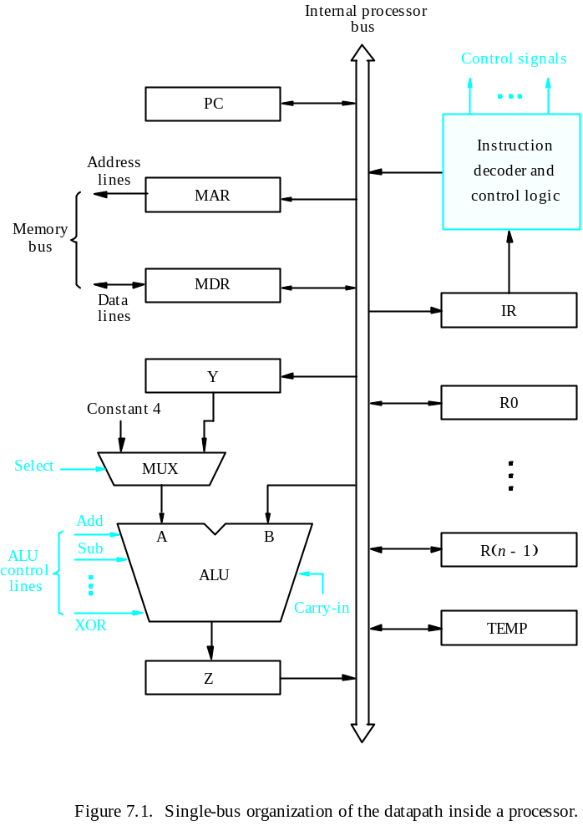
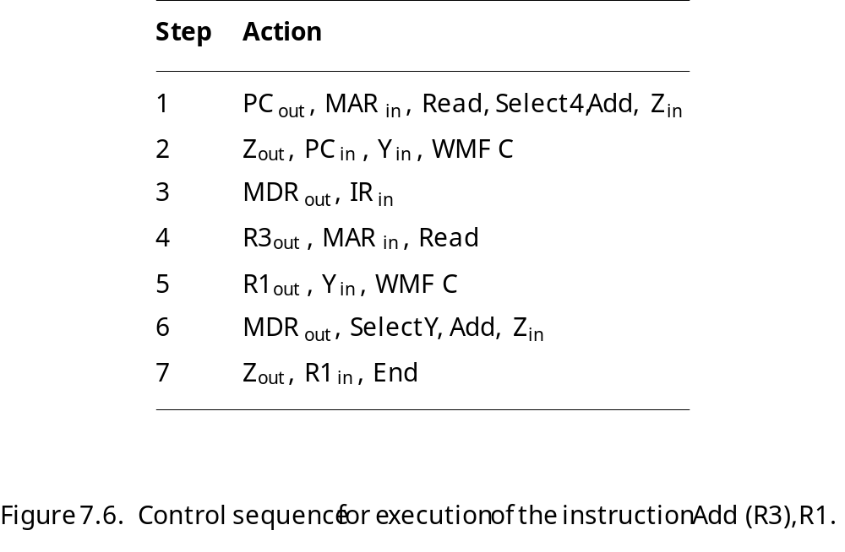
Execution of a Complete Instruction
Add (R3), R1

Slide 8
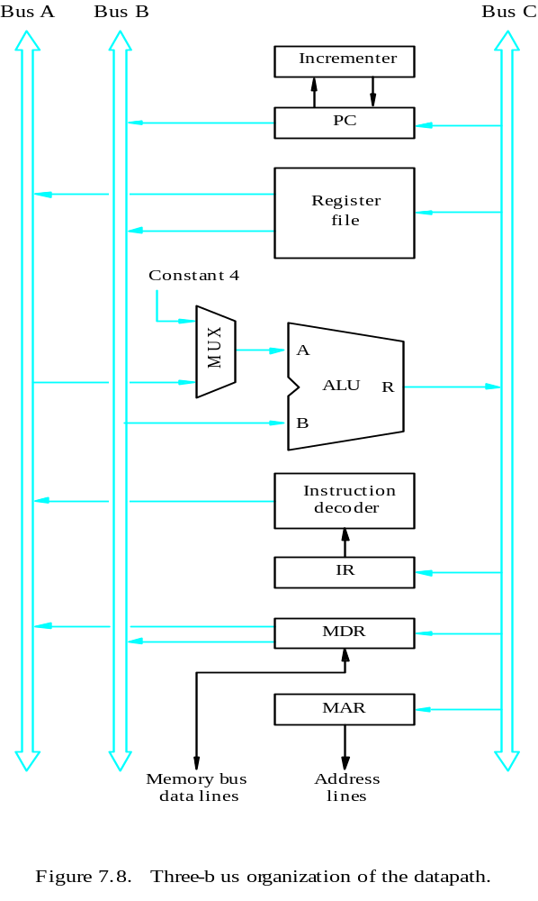
Multiple-Bus Organization
Allow the contents of two different registers to be accessed simultaneously and have their contents placed on buses A and B.
Allow the data on bus C to be loaded into a third register during the same clock cycle.
Incrementer unit.
ALU simply passes one of its two input operands unmodified to bus C
→ control signal: R=A or R=B

Slide 9
General purpose registers are combined into a single block called registers.
3 ports,2 output ports –access two different registers and have their contents on buses A and B
Third port allows data on bus c during same clock cycle.
Bus A & B are used to transfer the source operands to A & B inputs of the ALU.
ALU operation is performed.
The result is transferred to the destination over the bus C.

Slide 10
ALU may simply pass one of its 2 input operands unmodified to bus C.
The ALU control signals for such an operation R=A or R=B.
Incrementer unit is used to increment the PC by 4.
Using the incrementer eliminates the need to add the constant value 4 to the PC using the main ALU.
The source for the constant 4 at the ALU input multiplexer can be used to increment other address such as loadmultiple & storemultiple

Slide 11
Multiple-Bus Organization
Add R4, R5, R6
Step
Action
1
PC
out
,
R=B,
MAR
in
,
Read,
IncPC
2
WMF
C
3
MDR
outB
,
R=B,
IR
in
4
R4
outA
,
R5
outB
,
SelectA,
Add,
R6
in
,
End
Figure 7.9. Control sequence for the instruction. Add R4,R5,R6,
for the three-bus organization in Figure 7.8.

Slide 12
Step 1:The contents of PC are passed
through the ALU using R=B control signal & loaded into MAR to start a memory read operation
At the same time PC is incrementer by 4
Step 2:The processor waits for MFC
Step 3: Loads the data ,received into MDR ,then transfers them to IR.
Step 4: The execution phase of the instruction requires only one control step to complete.

Slide 13
Exercise
What is the control sequence for execution of the instruction
Add R1, R2
including the instruction fetch phase? (Assume single bus architecture)

Slide 14
Hardwired Control

Slide 15
Overview
To execute instructions, the processor must have some means of generating the control signals needed in the proper sequence.
Two categories: hardwired control and microprogrammed control
Hardwired system can operate at high speed; but with little flexibility.

Slide 16
Control Unit Organization
Clock
CLK
Control step
counter
External
inputs
Decoder/
IR
encoder
Condition
codes
Control signals
Figure 7.10. Control unit organization.

Slide 17
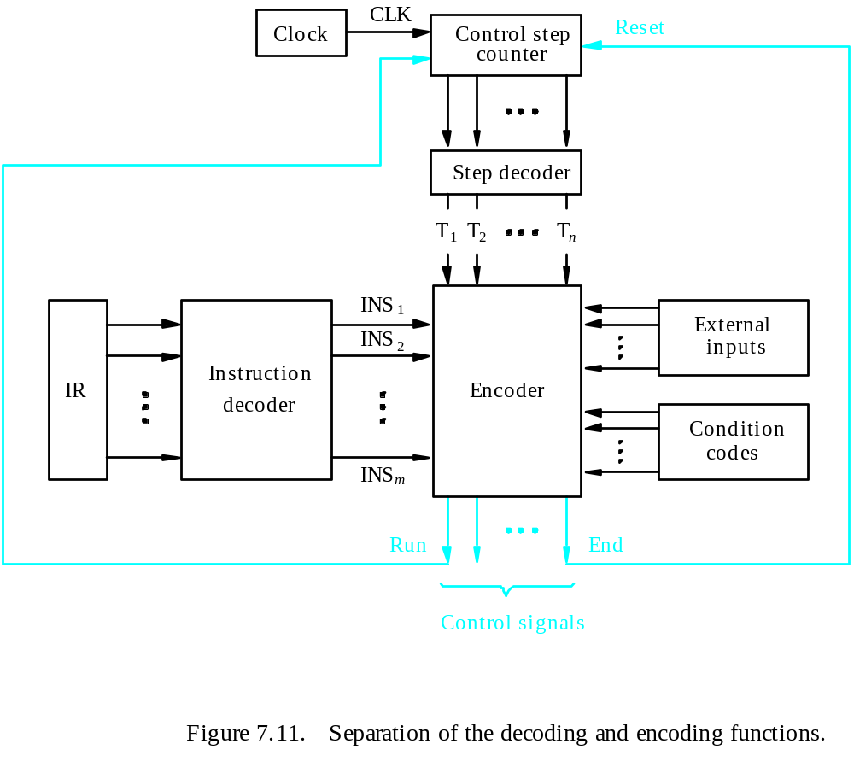
Detailed Block Description

Slide 18
Generating Z_{in}
Z_{in} = T₁ + T₆ • ADD + T₄ • BR + …
Branch
Add
T
4
T
6
T
1
Figure 7.12. Generation of the Z_{in} control signal for the processor in Figure 7.1.

Slide 19
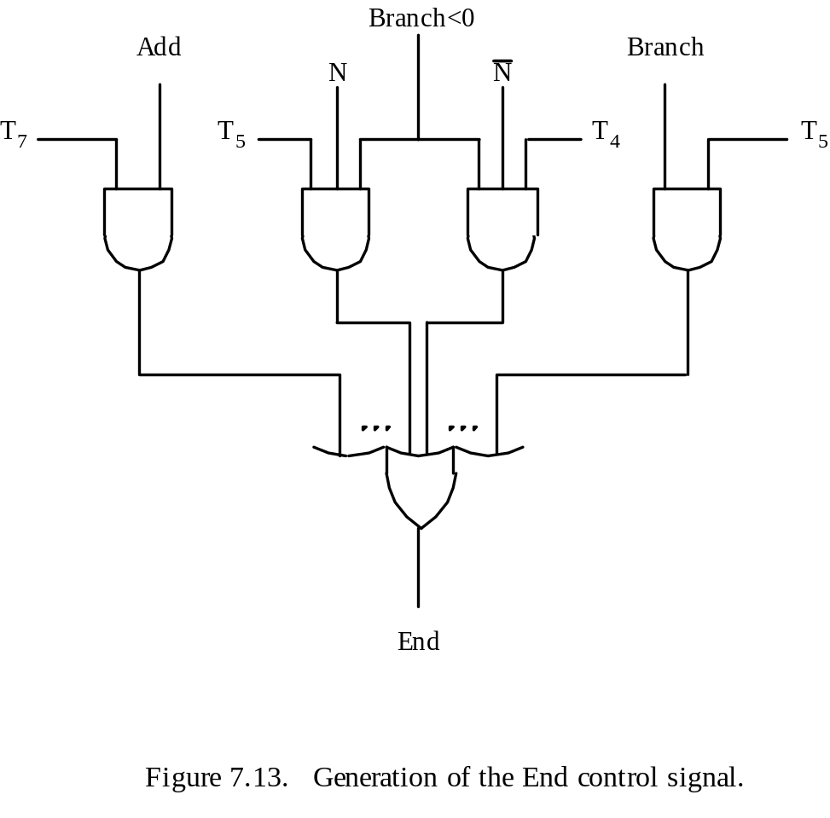
Generating End
End = T₇ • ADD + T₅ • BR + (T₅ • N + T₄ • N) • BRN +…

Slide 20
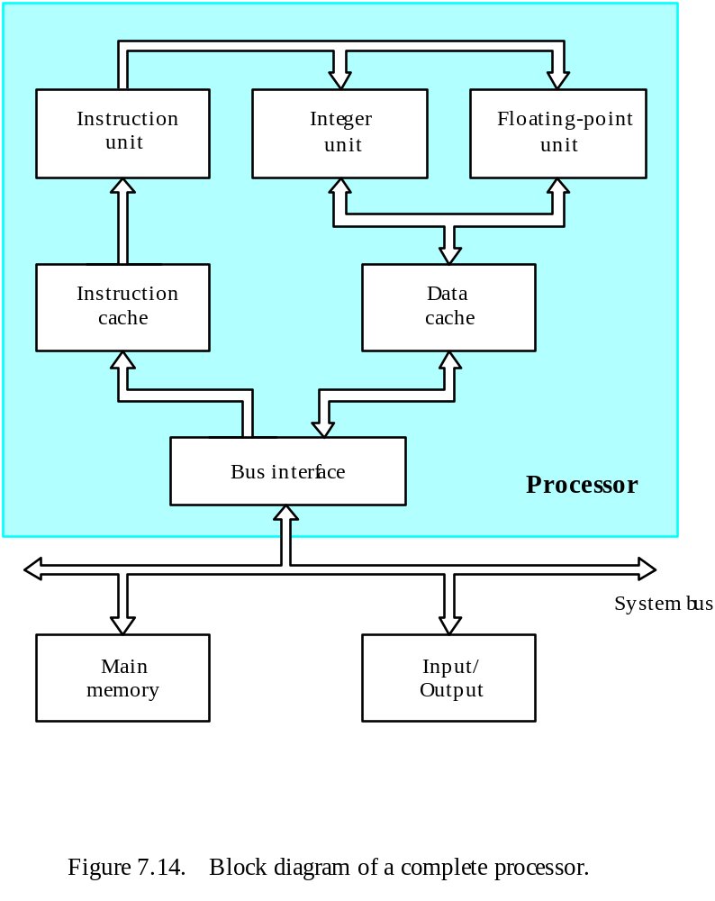
A Complete Processor

Slide 21
Microprogrammed Control

Slide 22
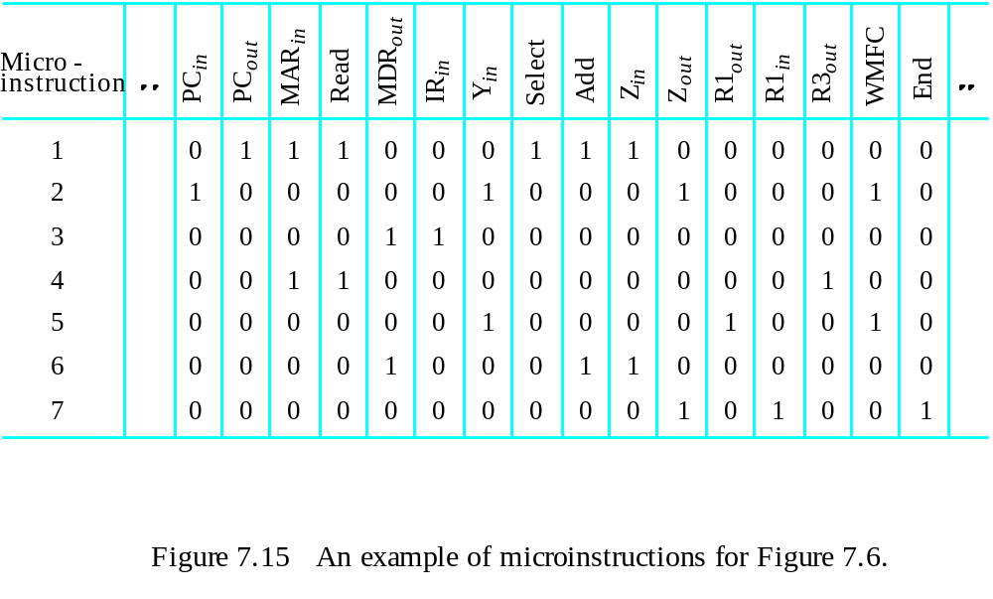
Microprogrammed Control
Control signals are generated by a program similar to machine language programs.
Control Word (CW); microroutine; microinstruction
: Textbook page430

Slide 23
Overview
Textbook page 421

Slide 24
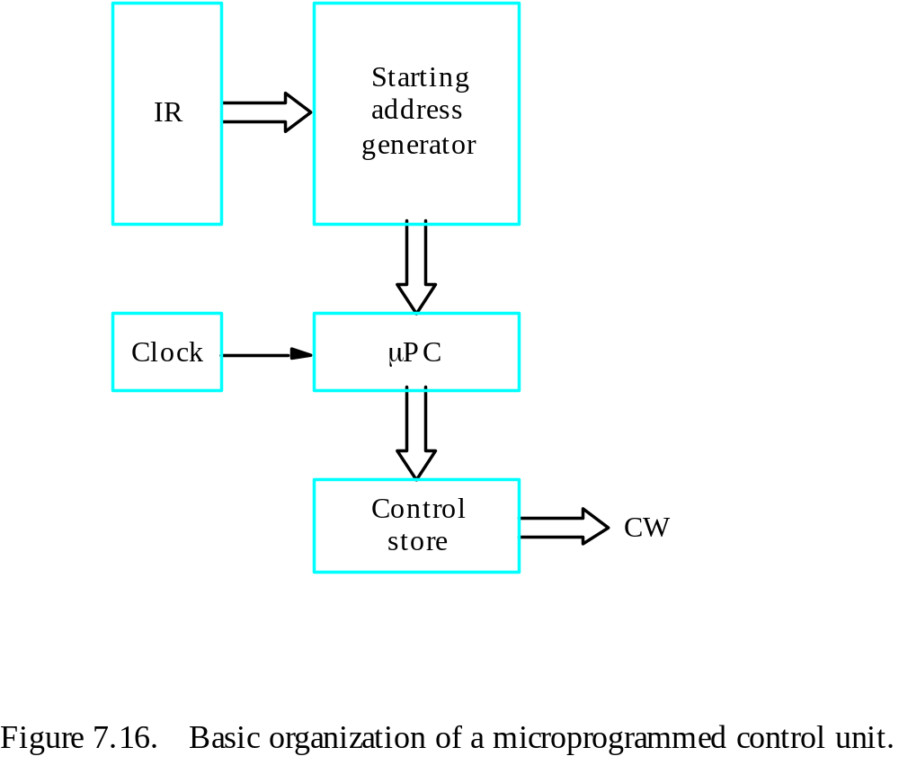
Basic organization of a microprogrammed control unit
Control store
One function
cannot be carried
out by this simple
organization.

Slide 25
Microprogrammed Control
External
inputs
Starting and
Condition
IR
branch address
codes
generator
Clock
μ
P
C
Control
CW
store
Figure 7.18. Organization of the control unit to allow
conditional branching in the microprogram.

Slide 26
Microinstructions
A straightforward way to structure microinstructions is to assign one bit position to each control signal.
However, this is very inefficient.
The length can be reduced: most signals are not needed simultaneously, and many signals are mutually exclusive.
All mutually exclusive signals are placed in the same group in binary coding.

